Slide 1
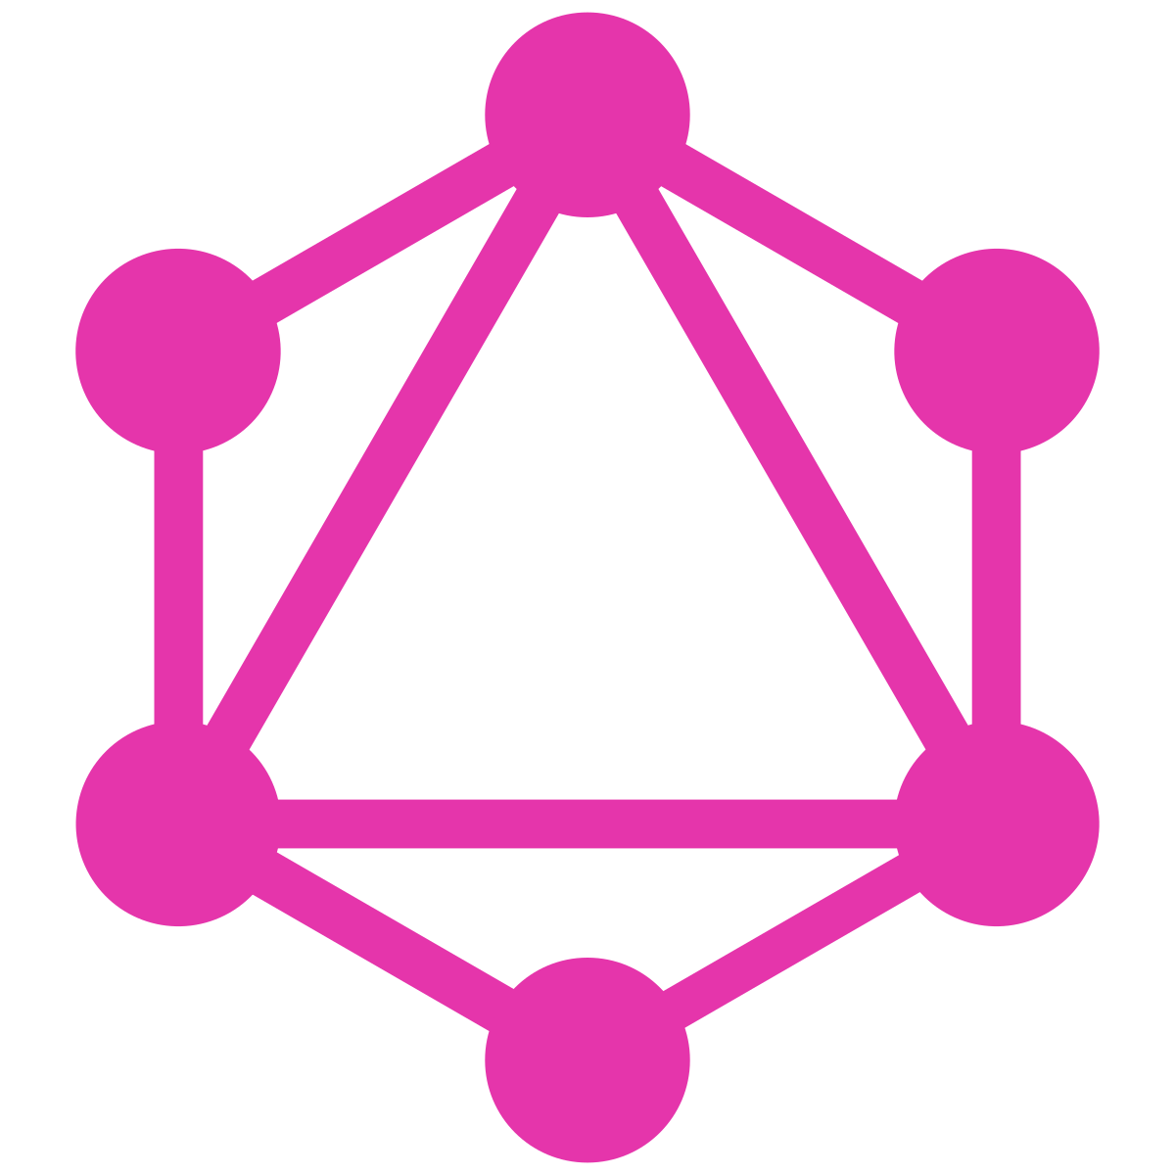
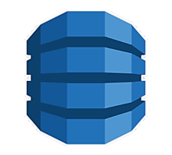
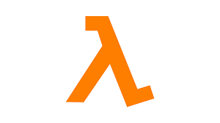
DEMO - GraphQL
BY
Murugesan D

Slide 2
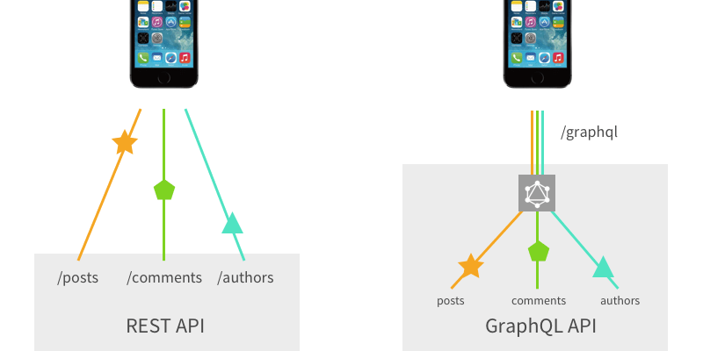

Slide 3
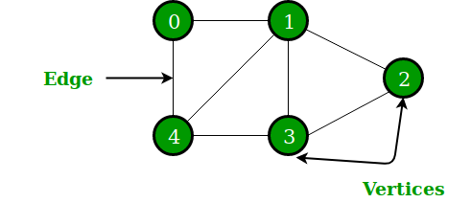
the set of edges E = {01, 12, 23, 3
A Graph consists of a finite set of vertices(or nodes) and set of Edges which connect a pair of nodes. Consider the above example vertices V = {0,1,2,3,4} and the set of edges E = {01, 12, 23, 34, 04, 14, 13}.

Slide 4
Graph Relations between books and author
Here Author and book are vertices and author id is edges.
Author ID
Books
Authors

Slide 5
Diff between REST and GRAPHQL
A REST API is an architectural concept for network-based software. GraphQL, on the other hand, is a query language, a specification, and a set of tools that operates over a single endpoint using HTTP. In addition, over the last few years, REST has been used to make new APIs, while the focus of GraphQL has been to optimize for performance and flexibility.

Slide 6
GraphQL follows the same set of constraints as REST APIs, but it organizes data into a graph using one interface. Objects are represented by nodes (defined using the GraphQL schema), and the relationship between nodes is represented by edges in the graph. Each object is then backed by a resolver that accesses the server’s data.

Slide 7
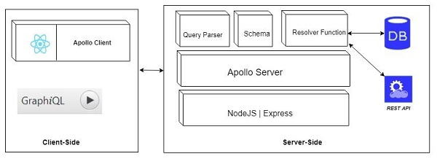

Slide 8
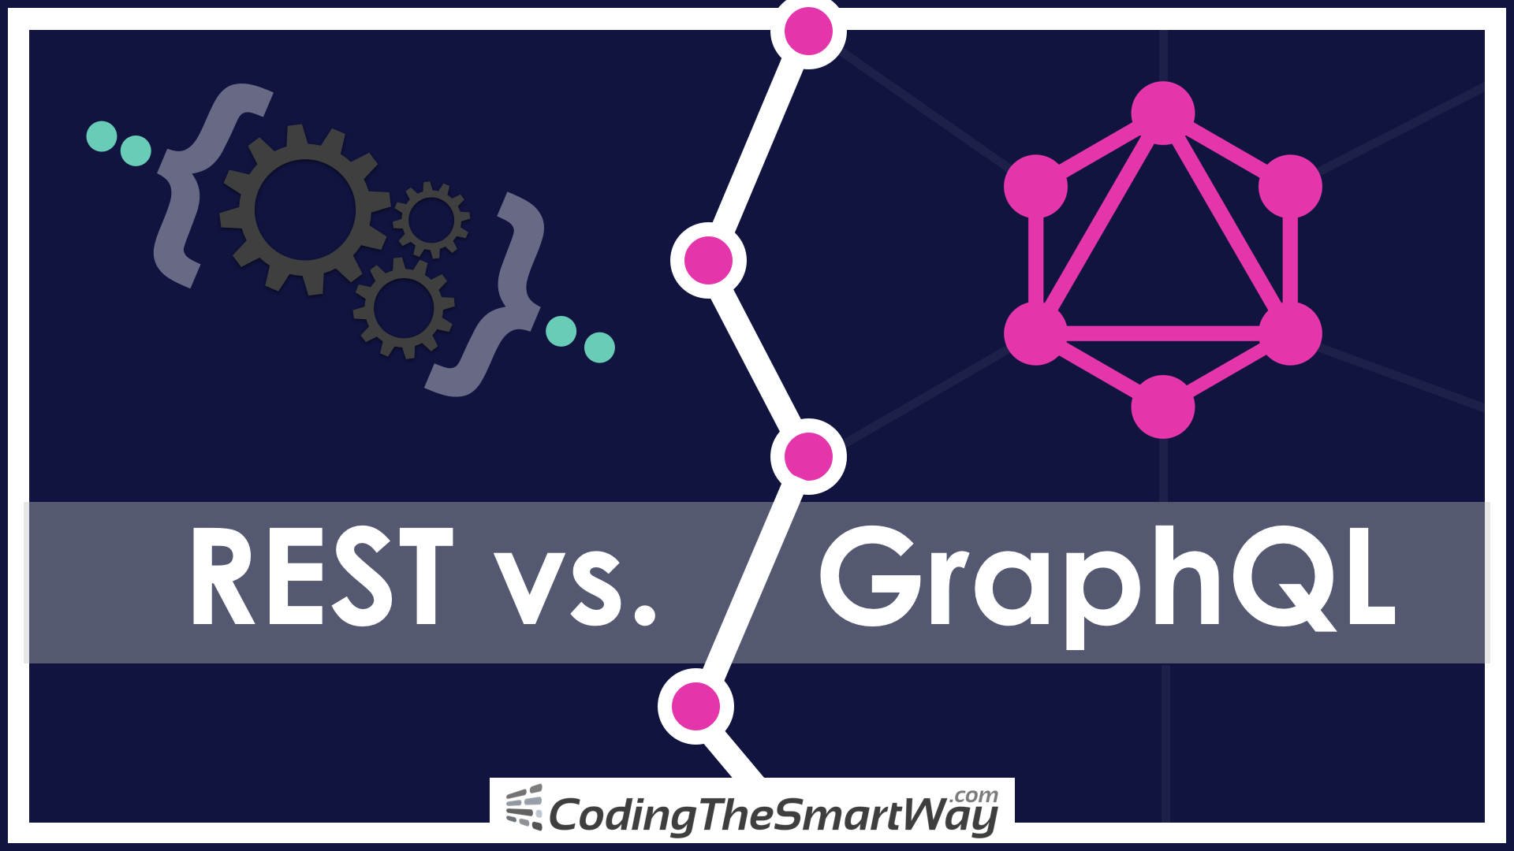

Slide 9
Thank you

